Slide 1
Progress in Devices and Information Theory (What’s going on in EE)
Babak Hassibi
California Institute of Technology

Slide 2
EE at Caltech in a Nutshell
Founded in 1910
centennial celebration this Fall!
15-35 undergrads per class over last 10 years
undergraduate program ABET accredited
12-24 PhDs and 9-15 terminal MS degrees per year
Around 800 applicants per year to graduate program
20% of all graduate applicants to Caltech
compete quite well with MIT, Stanford, Berkeley
Graduate program ranked consistently 4-5 by USN&WR
all other top 10 schools at least 3x our size (smallest is Cornell)
MIT, Stanford, Berkeley at least 5x our size
first in citations per faculty member

Slide 3
Challenges
How to maintain and enhance our tradition of excellence?
Educational program
undergraduate course offerings competitive/superior
number of graduate courses less than half our competitors
need more funding for instructors
consolidating courses with the rest of IST and EAS
Research Program
EE is fortunate to have endowed fellowships
but need much more (x2)

Slide 4
Research in EE
Circuits and VLSI (Em, Haj, R, Sch, T)
Communications (B, Eff, Has, Ho, V)
Control (D, Has)
Devices (Haj, R, Sch, T, Yan, Yar)
Images and Vision (Eff, P, V)
Information Theory (A, B, Eff, Has, Ho, V)
Learning and Pattern Recognition (A, B, P)
MEMS (Sch, T)
Networks (B, Has, Ho, L)
Electromagnetics, Optics, Opto-electronics (Em, R, Sch, Yan, Yar)
RF, Microwaves, Antennas (Em, Haj, R)
Signal Processing (B, Eff, Has, Per, V)

Slide 5
Highlights in Devices

Slide 6

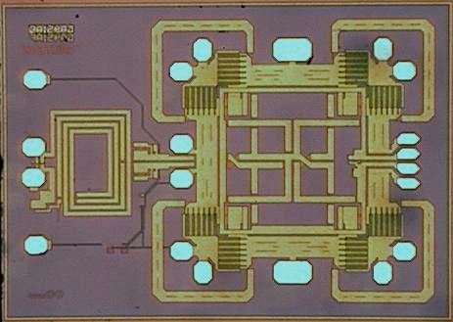
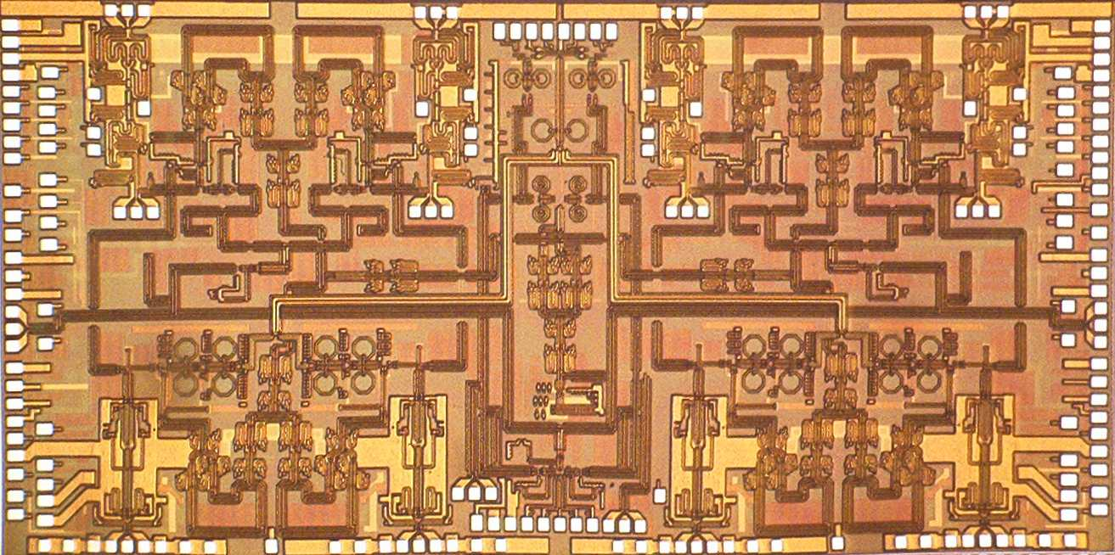
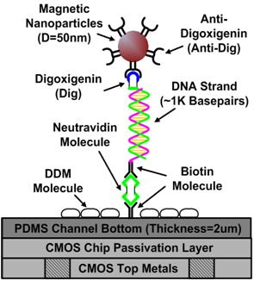
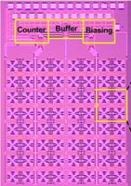
Caltech High-performance Integrated Circuits (Hajimiri Group)
We focus on integrated circuits and their applications in various disciplines, e.g., sensing, communications, and biotech, investigating both theoretical and experimental aspects.
Wireless Communications:
World first and only fully-integrated CMOS power amplifier for cellular.
Based on Caltech technology and commercialized by Axiom
Microdevices Inc. (now Skyworks Inc.).
Shipped 50 Million units till April 2009. Currently shipping more than
10 Million per quarter.
Sensors:
Complete phased array Radar-On-a-Chip.
Silicon-based phased array transceiver with on-chip antennas.
Enables low-cost, high resolution imaging radar for automotive
and robotics applications.
Bio-Sensing:
Single molecule bio-sensor for DNA and RNA.
Ultra-low cost portable sensor array for handheld early diagnostics
and disease monitoring.
Based on a CMOS magnetic sensor developed at Caltech.

Slide 7

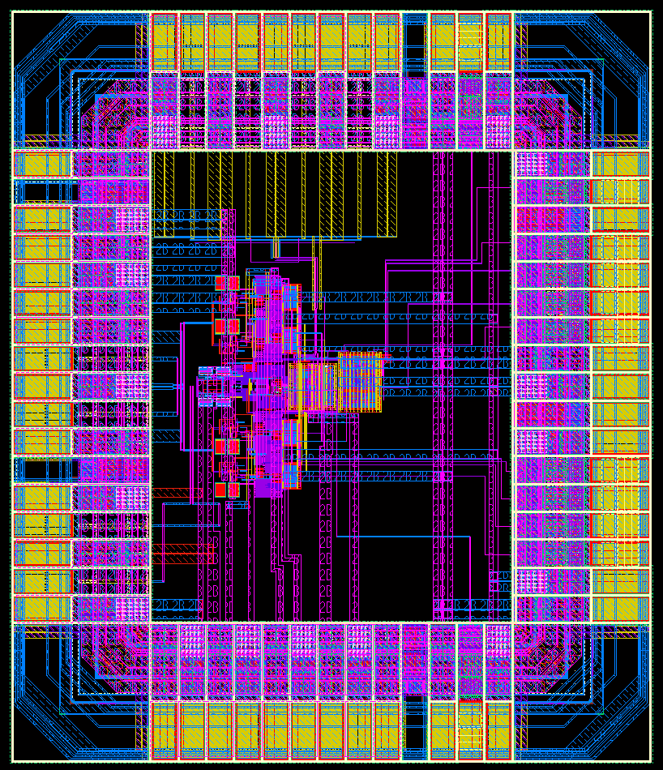
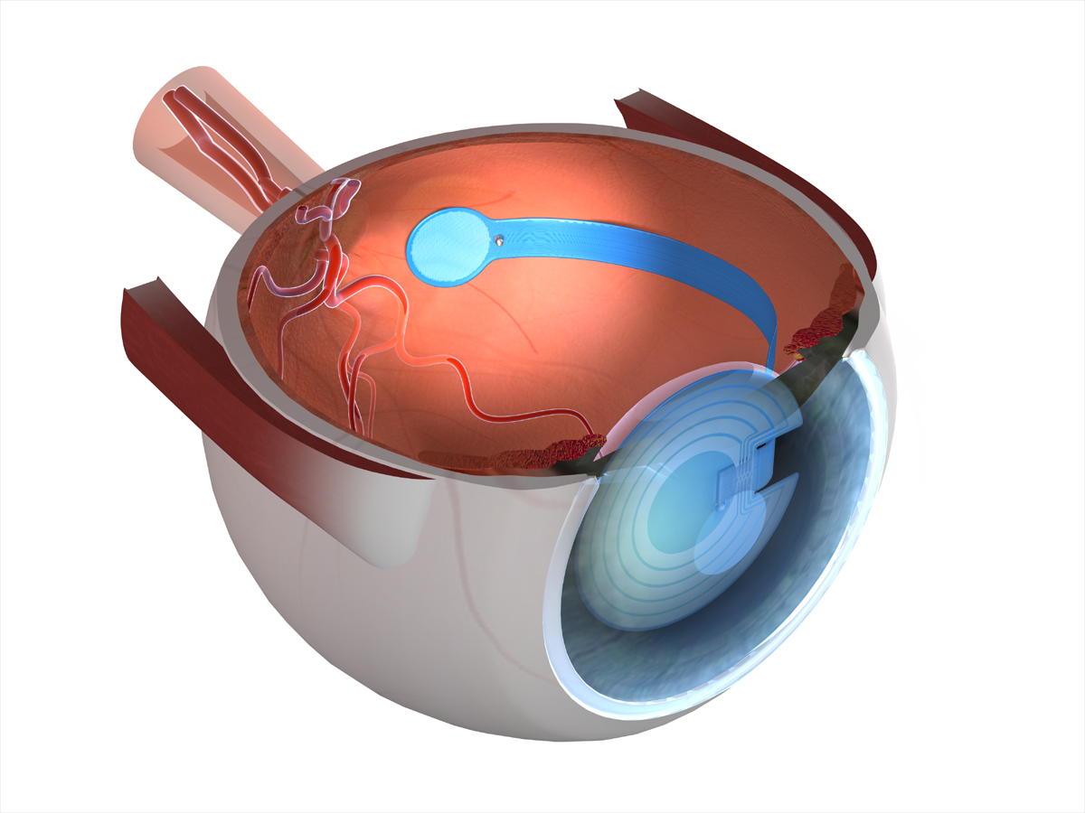
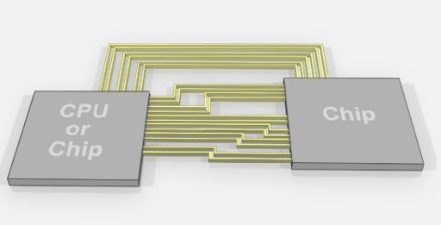
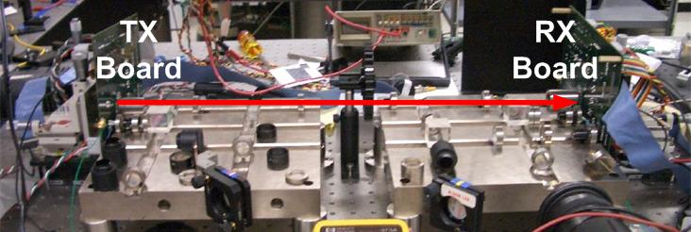
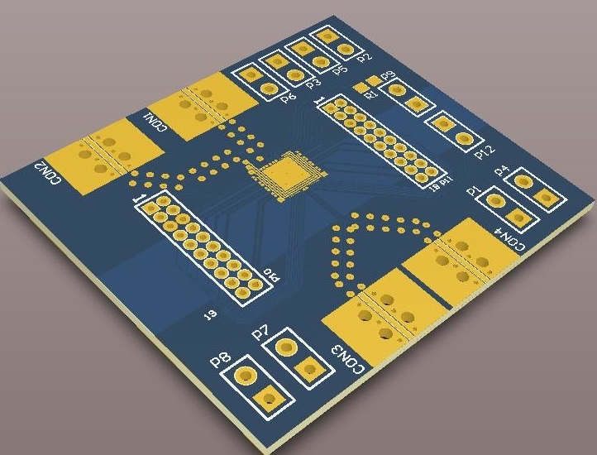
Mixed Mode Integrated Circuits (Emami Group)
Architectures and circuits for the future processing, communication and medical systems
On-chip networks and high-speed signaling for multi-processors and 3D integrated systems
Next generation neural implants
Compressive sensing
Adaptive circuits and systems
IC Chip

Slide 8

Opt. & Quant. Electron. Lab, Prof. A. Yariv
Hybrid Si/III-V photonics
Low-temperature wafer bonding
Longitudinal supermode control in hybrid lasers
Enhance laser modal gain
Reduce threshold and increase slope efficiency
Make for more efficient and shorter devices
Room temperature c.w. hyrid Si lasers
Phase-locked and Swept-Frequency Lasers
Semiconductor lasers (SCLs) in optoelectronic phase-lock loops
Coherence cloning
Phased array beam steering
Swept-frequency SCL sources
Frequency modulated imaging / ranging
Label free biosensing
Slow light amplifiers and lasers
Slow light by coupled-resonator optical waveguides (CROWs)
Effect by slow light:
Longer photon lifetime
Enhanced optical gain and long effective length
Active slow light
Compact optical amplifiers and lasers
Lasers with low threshold current and narrow linewidth
Slow light lasers by grating CROWs
PS: phase shift
mirror
resonators
mirror

Slide 9

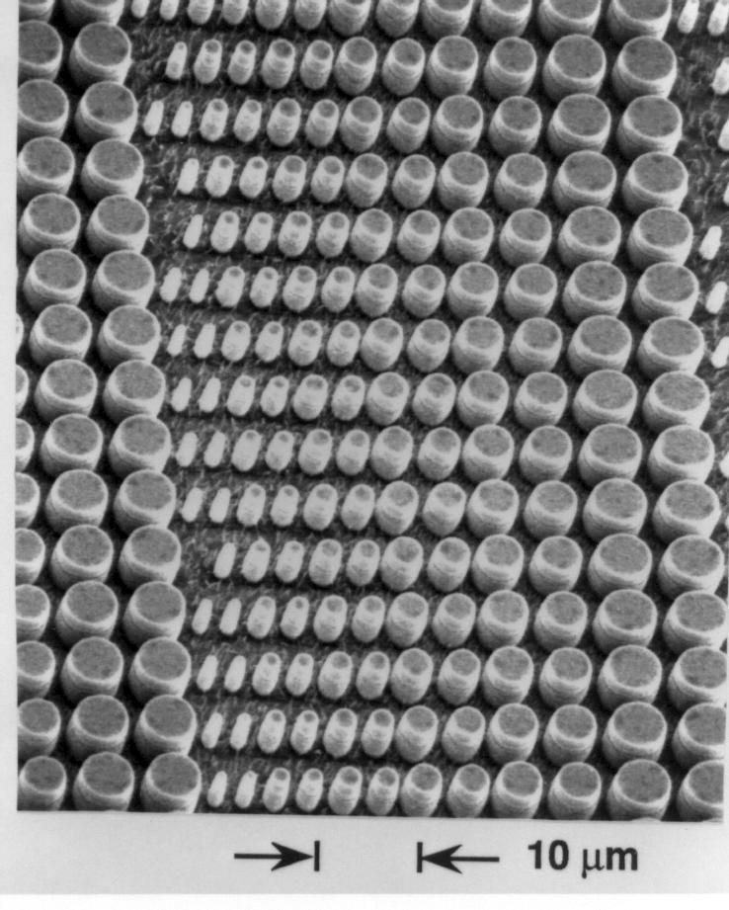
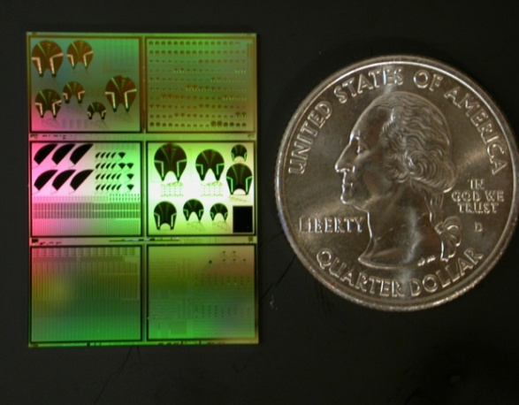
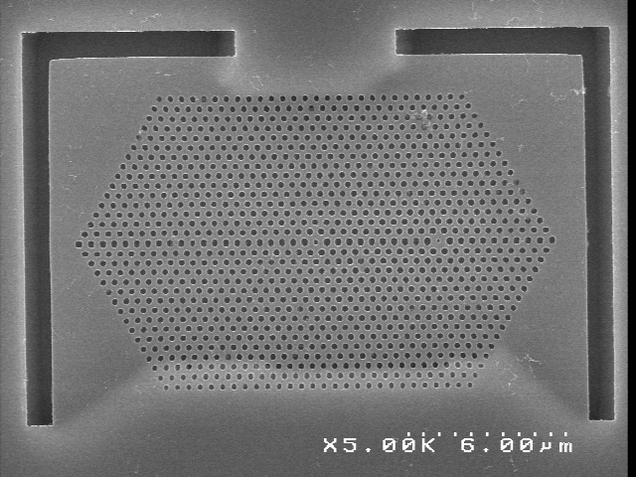
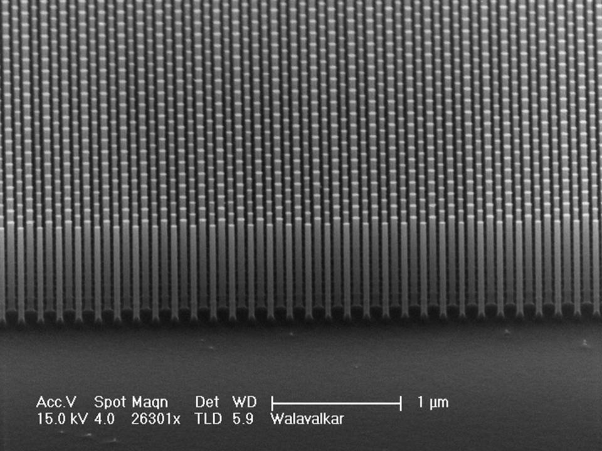
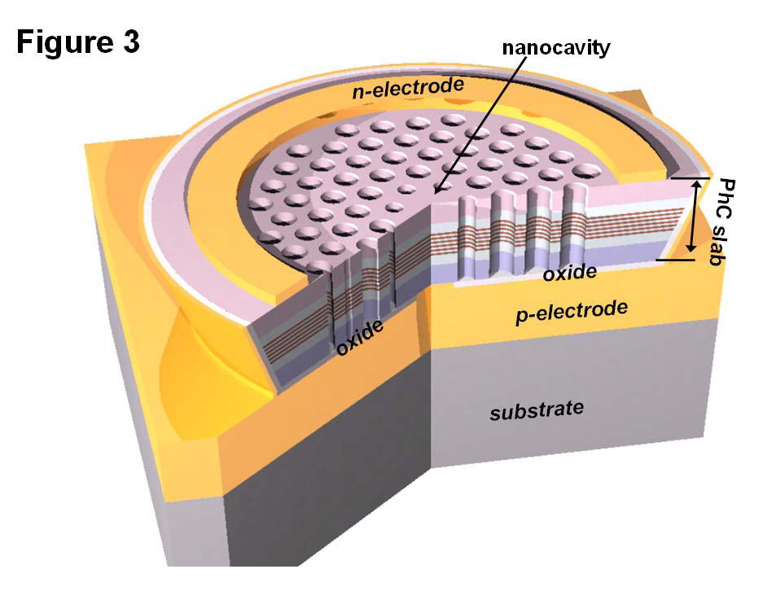
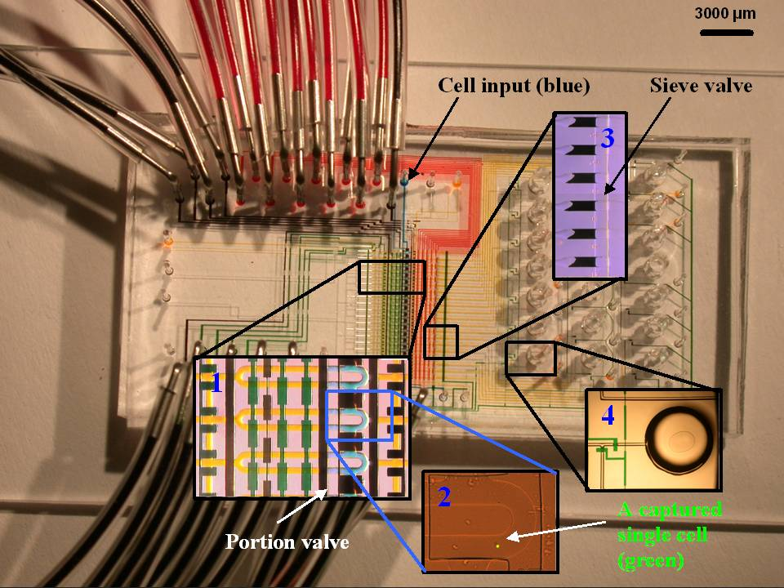
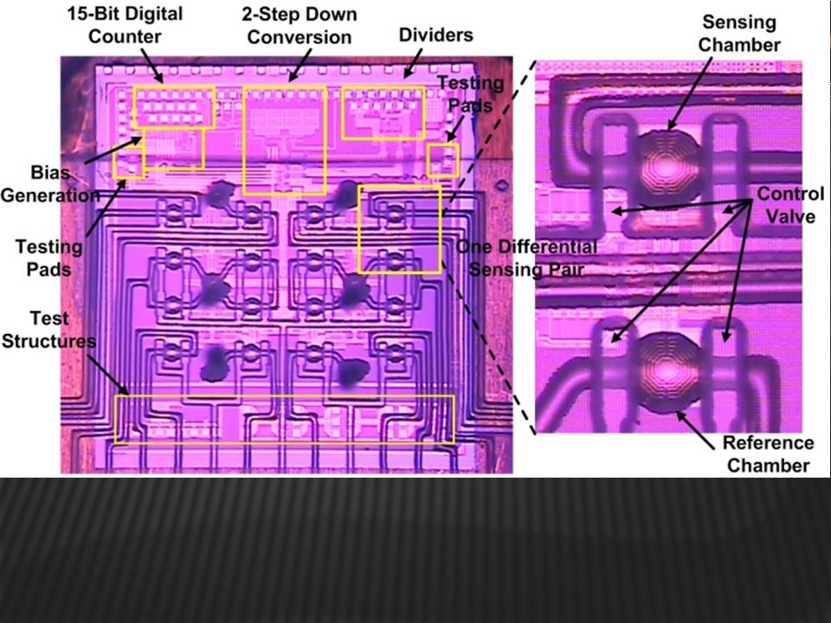
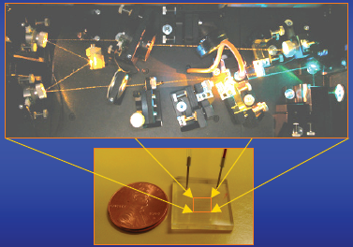
Axel Scherer: Integration of Photonic, Fluidic and Magnetic Nanodevices
VCSELs
CMOS photonics
Photonic crystal lasers
Silicon nanostructures
Research goals:
Integration of nano-devices on silicon
Miniaturization of systems
Biomedical diagnostic tools
Plasmon lasers
Single cell analysis system
Magnetic bead sensors
Microfluidic Dye Lasers

Slide 10

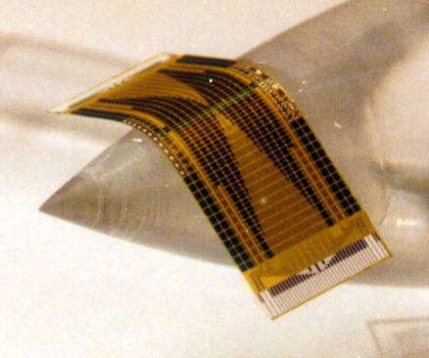
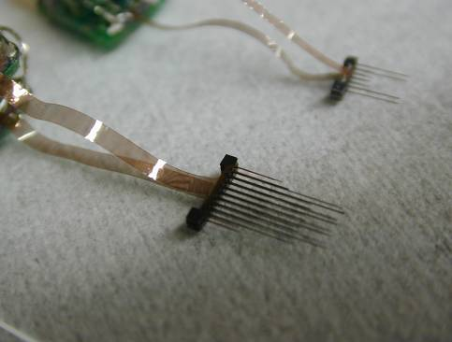
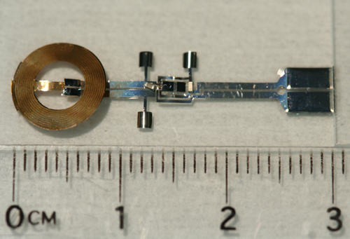
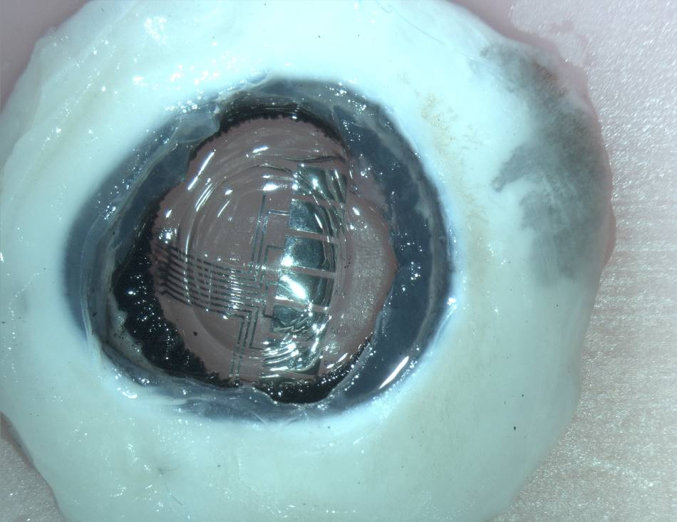
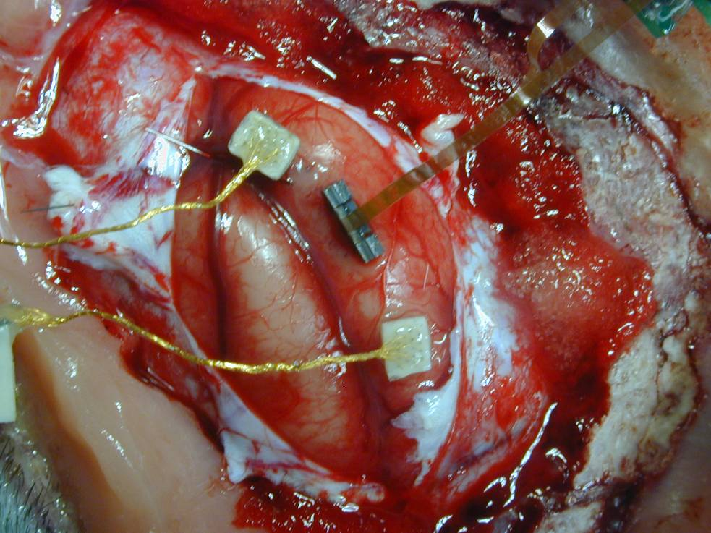
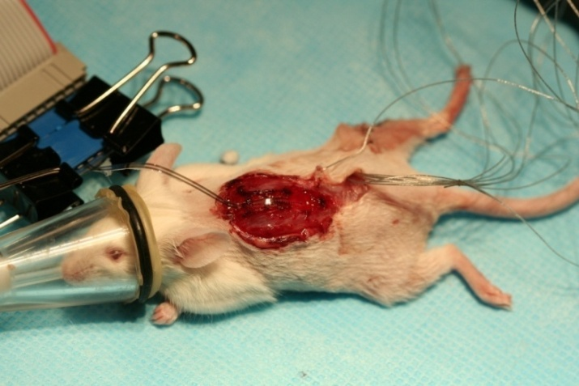
Micro implants for Retinal, Cortical and Spinal Applications YC Tai, Prof. of EE, Caltech
MEMS flexible sensor
IC-integrated Micro implants
Retinal implant in pig’s eye
Cortical implant in monkey brain
Spinal cord implant for rats

Slide 11
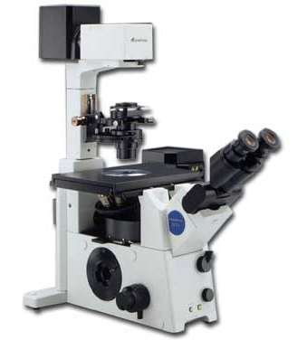
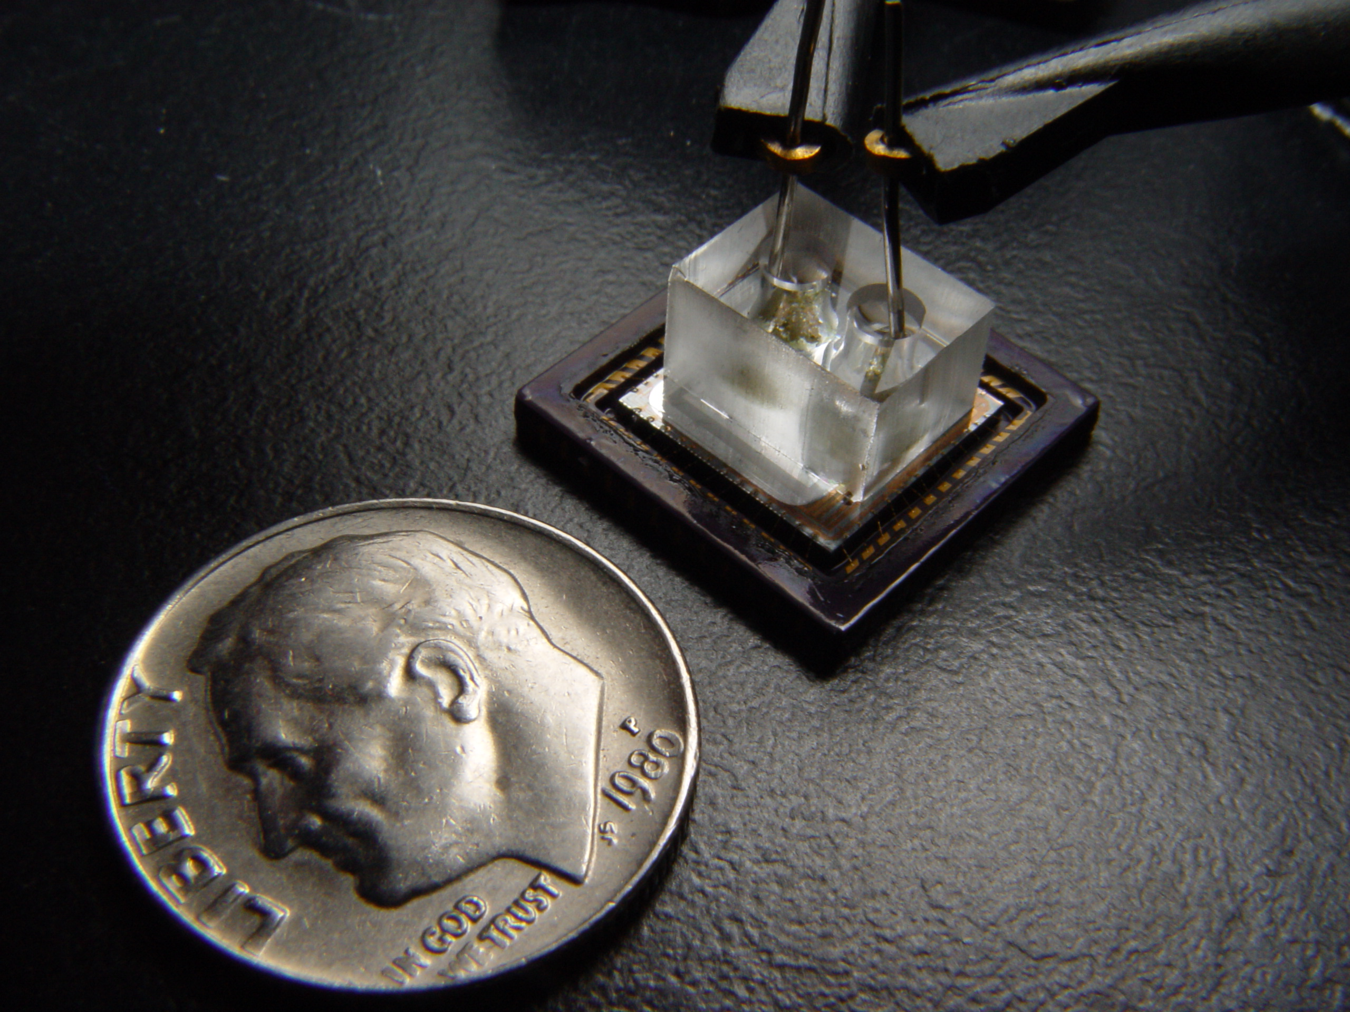
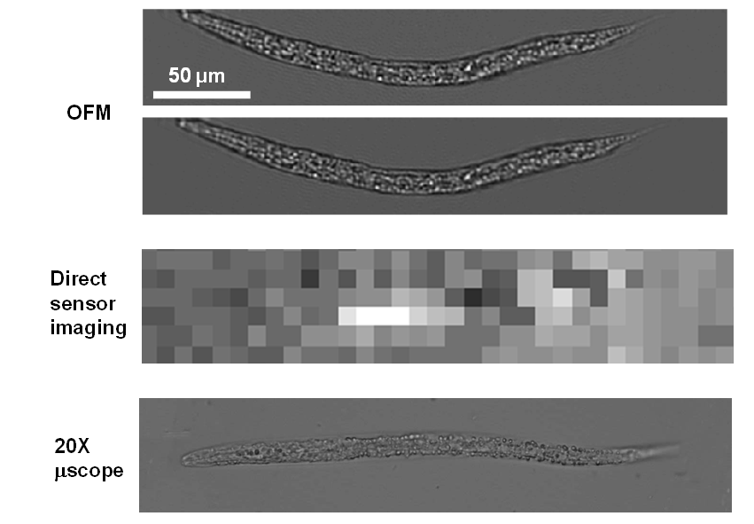
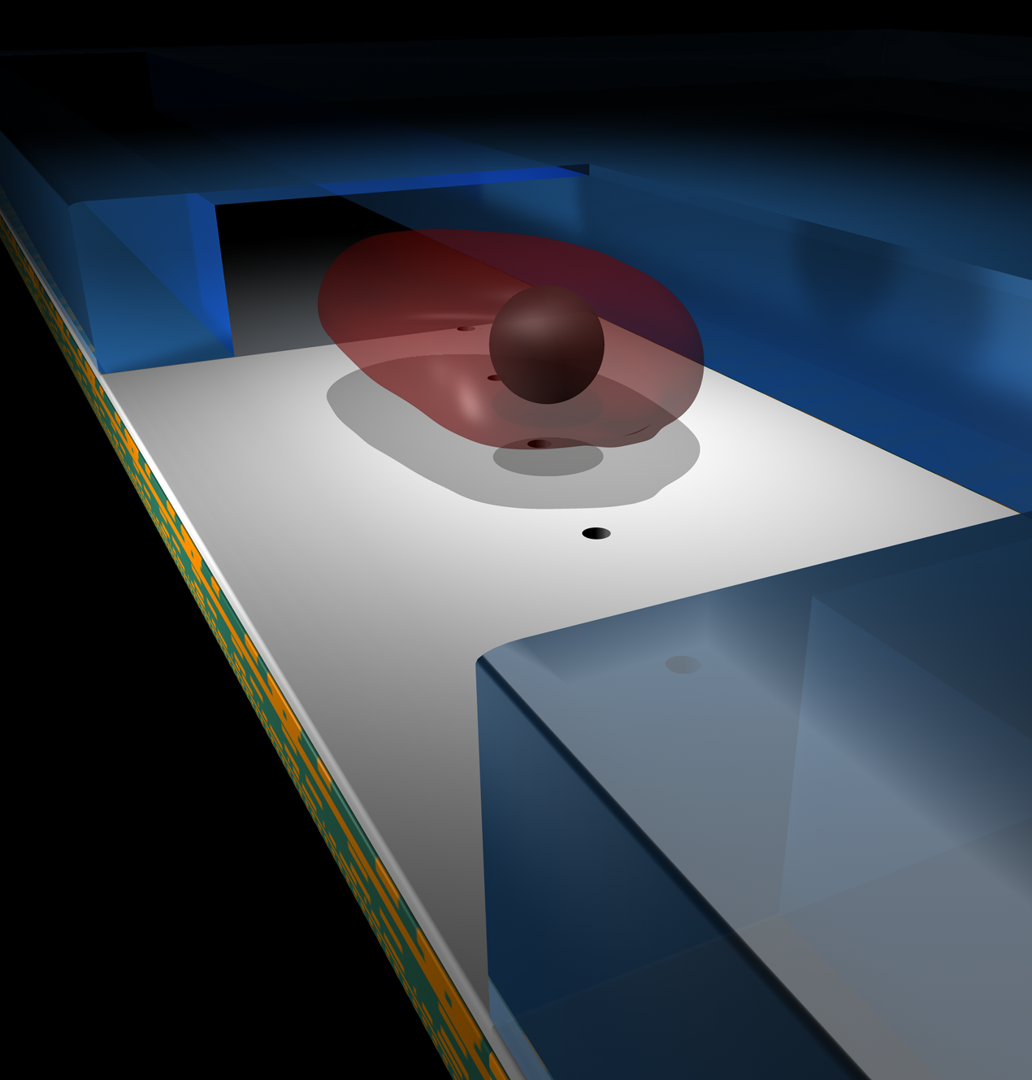
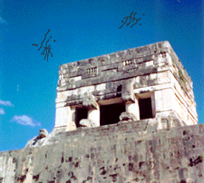

$10 On-Chip Microscope System – High-resolution, Cheap, and Compact
optofluidic microscope
conventional
microscope
The optofluidic microscope (OFM) enables high-resolution (~ 1 micron) on-chip cell and micro-organism imaging by drawing inspiration from the ‘floater’ phenomenon. The system is lensless, high-resolution and cheap to mass-produce.
floaters in our eyes
Changhuei Yang’s group

Slide 12
Highlights in Information Theory

Slide 13

Molecular Computing (Bruck)
Goal: Using DNA strands to create molecular computing circuits for
generating probability distributions
Applications: creating a global behavior (dosage of insulin) using a large
Collection of independent cells that react to global variables (glucose level)
Developed a theory and algorithms for synthesis: synthesize stochastic
switching circuits – a switch is a random variable – closed with probability 1/2
A relay circuit for 11/16
Implementation using DNA Toehold branch migration
Selected papers:
- Wilhelm and Bruck, “Stochastic Switching Circuit Synthesis,” IEEE International Symposium on Information Theory, 2008
- Loh, Zhou and Bruck, “The Robustness of Stochastic Switching Networks,” IEEE International Symposium on Information Theory, 2009
- Zhou and Bruck, “On the Expressability of Stochastic Switching Circuits,” IEEE International Symposium on Information Theory, 2009
- Soloveichik, Cook, Winfree and J. Bruck, “Computation with Finite Stochastic Chemical Reaction Networks,” Natural Computing, 2008
Molecular Programming Project – NSF Expeditions in computing program
Shuki Bruck, Caltech, February 2010

Slide 14

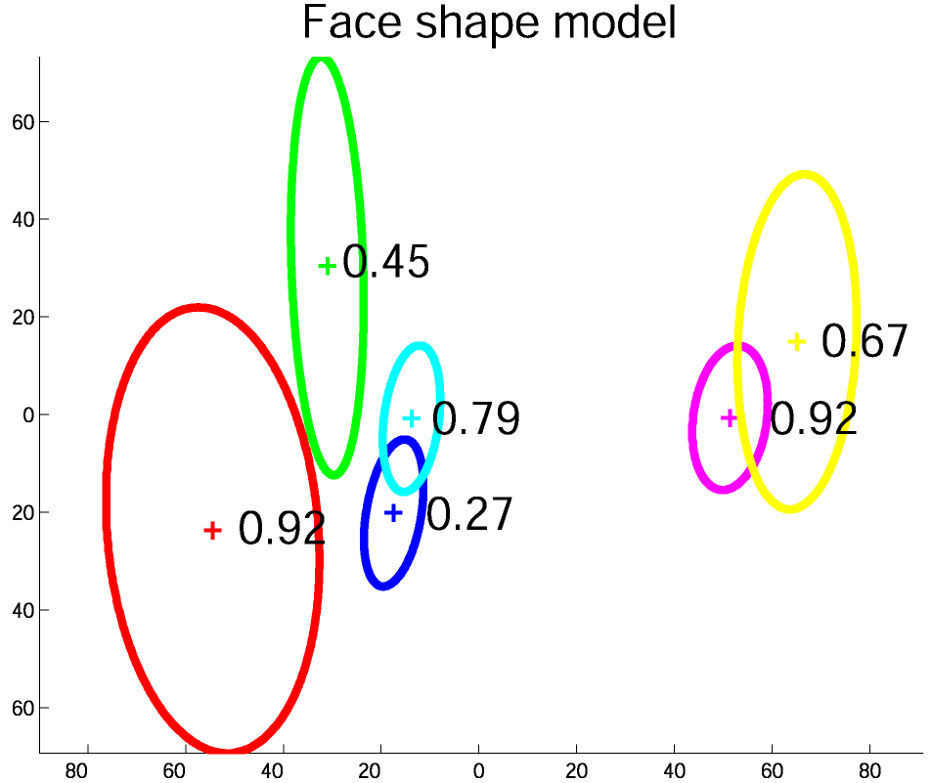
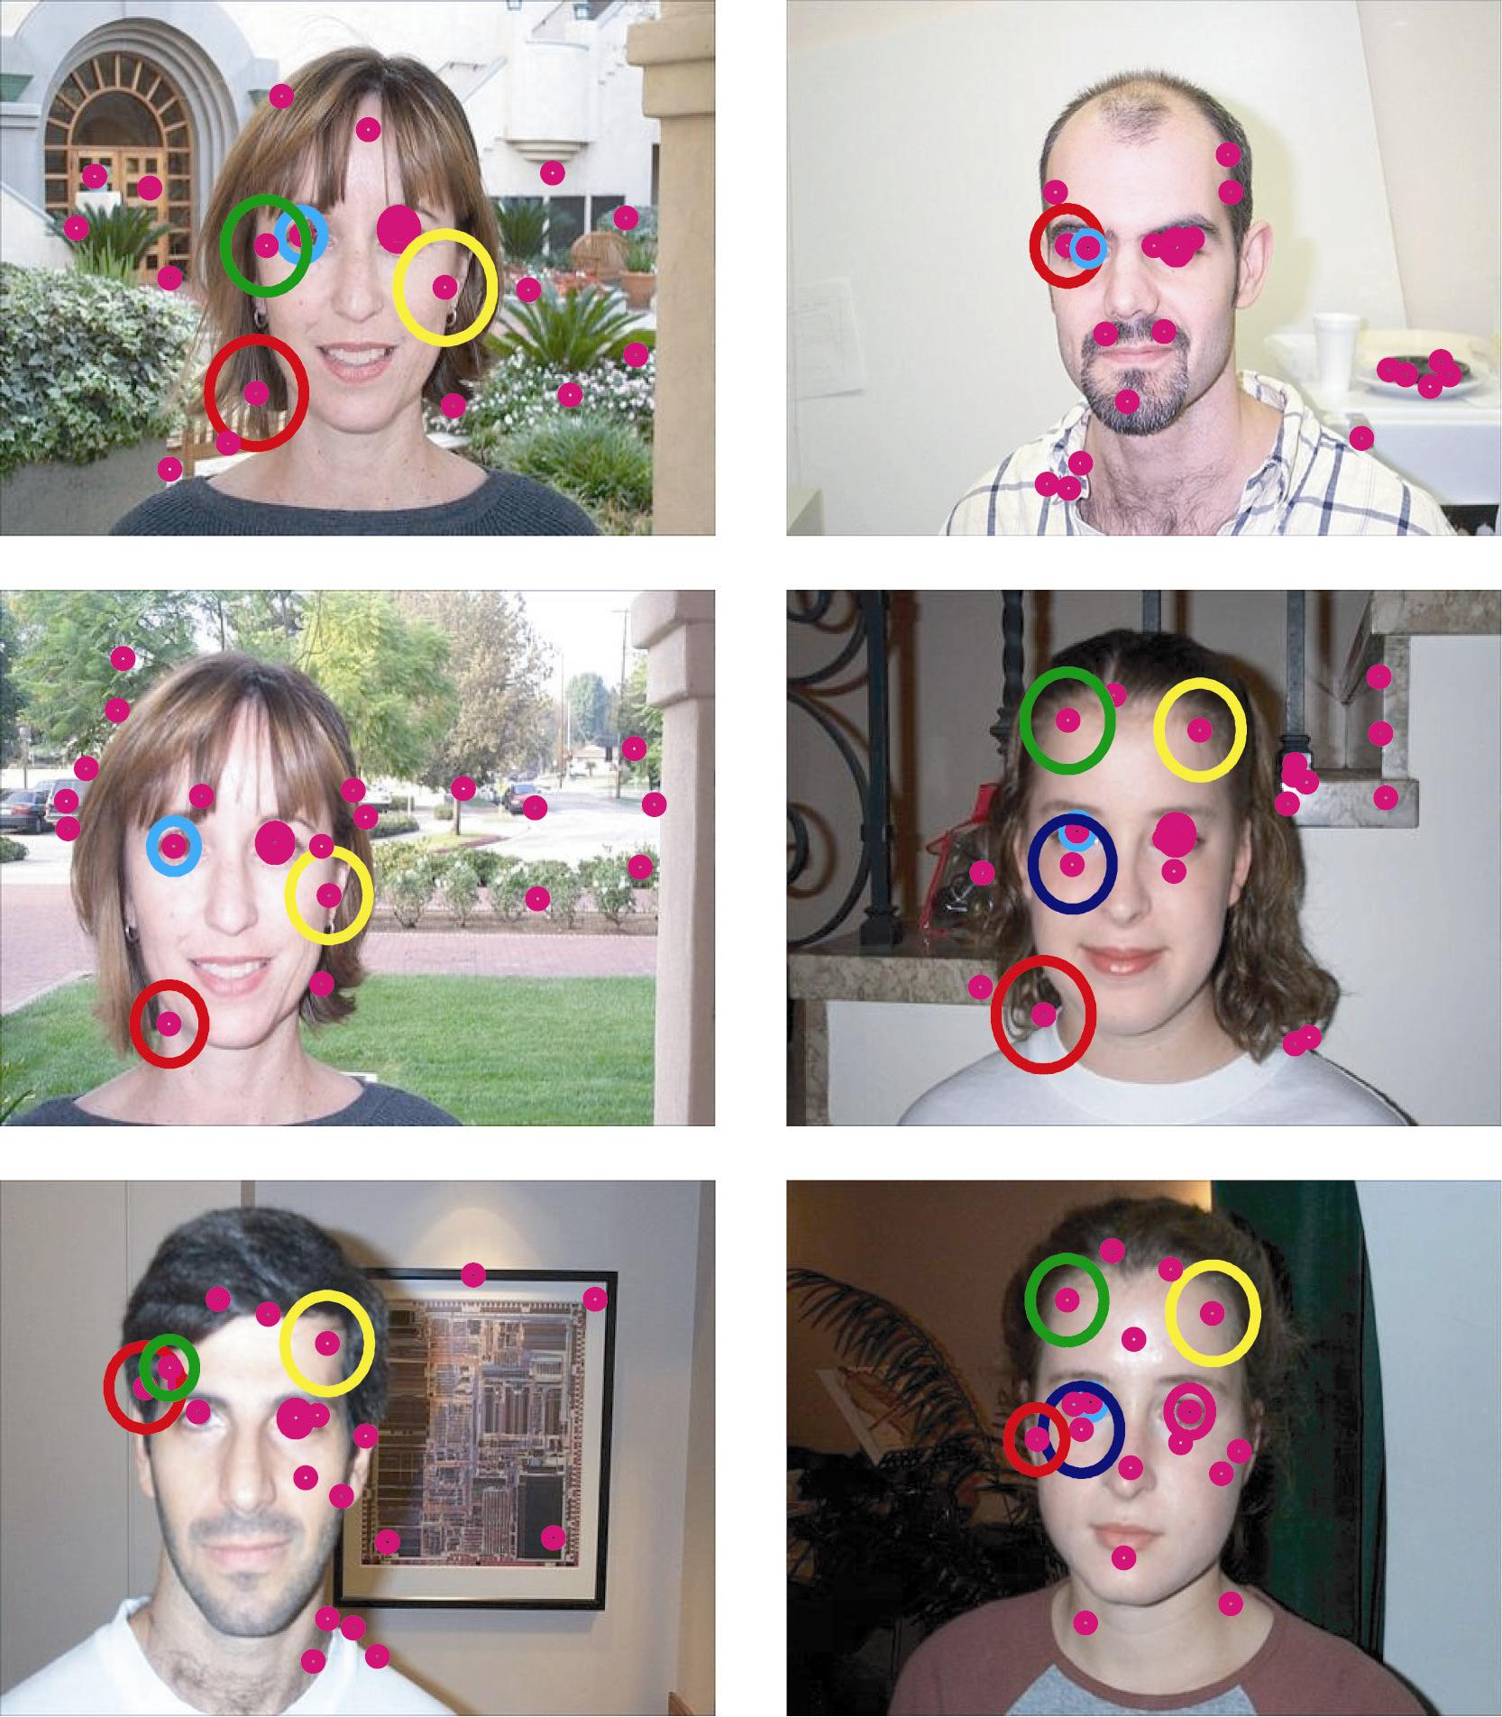
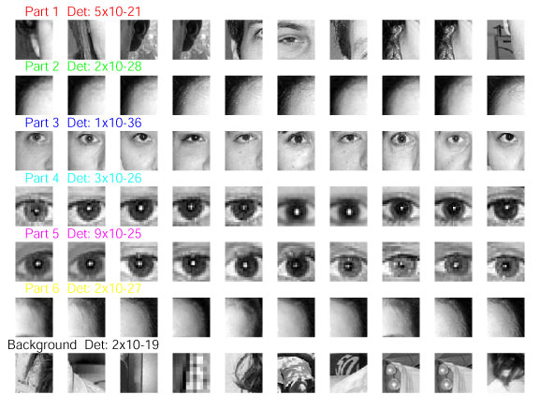
Visual Recognition (Perona)
Notes:
Professor Perona studies learning in visual recognition. One of the recent breakthoughs in his laboratory has been the ability to learn new visual categories (faces, motorcycles, leopards, ...) from a collection of images withough further human supervision. The algorithms are based on a Bayesian approach.
In this slide we see how a model (right hand side) has been learnt. The model includes parts (bottom right) such as eyes, the two corners of the forehead, a cheek, as well as the shape (top-right) of the category, i.e. the probability density function of the mutual position of such parts.

Slide 15





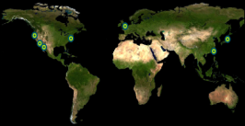

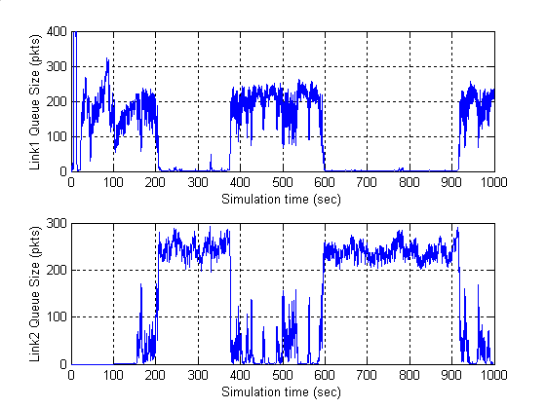
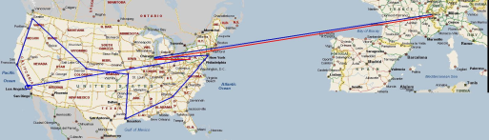




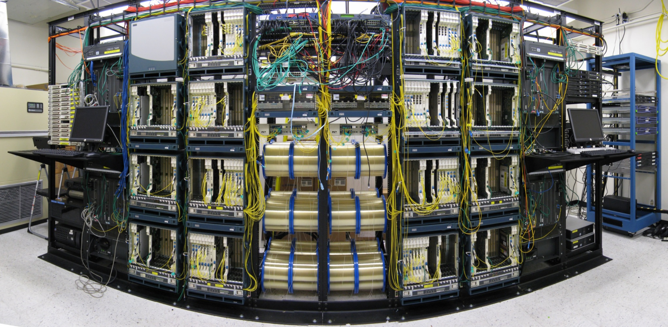







rsrg
NetLab
prof steven low
Lee Center
SISL
Caltech FAST Project
control & optimization of networks
2000
2001
2002
2003
2004
2005
2006
2007
theory
experiment
Lee Center
FAST TCP theory
IPAM Wkp
WAN-in-Lab Testbed
testbed
deployment
SC02 Demo
Collaborators: Profs Doyle (Caltech), Newman (Caltech), Paganini (Uruguay), Tang (Cornell), Andrew (Swinburne), Chiang (Princeton);
CACR, CERN, Internet2, SLAC, Fermi Lab, StarLight, Cisco, Level(3)
theory
testbed
experiment
deployment
Internet: largest distributed nonlinear feedback control system
WAN-in-Lab : one-of-a-kind wind- tunnel in academic networking, with 2,400km of fiber, optical switches, routers, servers, accelerators
Scientists have used FastTCP to break world records on data transfer between 2002 – 2006
FAST is commercialized by FastSoft; it accelerates world’s 2nd largest CDN and Fortune 100 companies
Reverse engineering: TCP is real-time distributed algorithm over Internet to maximize utility
TCP
FastTCP
eq 2
eq 3
SC 2004
eq 1
Internet2 LSR
SuperComputing BC
Forward engineering: Invention of FastTCP based on control theory & convex optimization
with FAST
without FAST

Slide 16


Slide 17

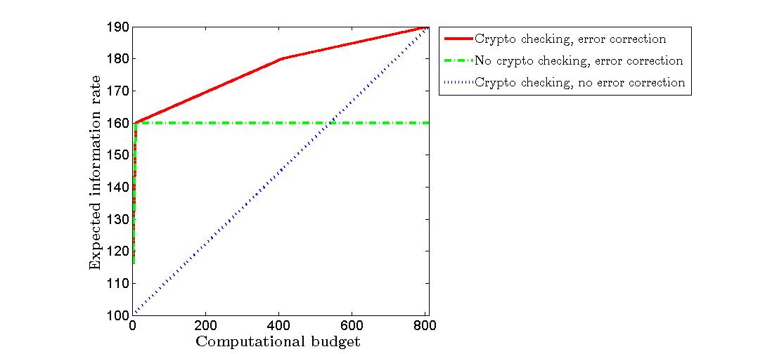
Information and coding in networks (Tracey Ho)
Security against active adversaries
Problem description: reliable communication over networks with adversaries that can arbitrarily corrupt information on limited but unknown portions of the network
Some recent results:
Multiple source multicast, homogenous error model:
Characterization of capacity region – showed that coding in the network allows redundant capacity to be shared among multiple sources, achieving the same transmission rates as if each source had exclusive use of the redundant capacity
Capacity-achieving polynomial-complexity code construction
Non-homogenous error model: new nonlinear coding strategies and outer bounds on capacity
Fountain-like network error correction code construction, which can be combined with cryptographic signatures (which are computationally more expensive) in a hybrid strategy useful in computationally limited settings
Robust distributed storage
Problem description: efficient storage of information across multiple storage nodes, for robustness to node failures/mobility
Some recent results:
Dominant storage cost, probabilistic failure model: characterization of optimal-cost storage allocation in the low and high probability of success regimes
Moderate mobility model: approximate optimization approach trading off dissemination/storage cost against recovery performance
Maximal spreading
Minimal spreading
Non-failure probability of each node
Storage budget`
Peer-to-peer networks
Problem description: modeling and analysis of peer-to-peer networks
Some recent results:
Showed various properties of the optimal strategies under different conditions, including static and dynamically changing scenarios and reciprocity constraints, using a coding optimization approach

Slide 18


Slide 19
Hassibi Group
Wireless communications
wireless networks, MIMO systems
Network information theory
optimization-based approach to capacity calculations
Distributed Estimation and Control
control lossy networks, flight formation, smart grid
Signal Processing
real-time microarrays, compressed microarrays

Slide 20
Thank you!

